Slide 1
CourseFlow
A Course Registration Software
Presented by Bigger Data
Amanda Farghli, Desiree Caceres, Jaime Perez, Suhana Lama, Tak Kit Yeung
10/30/2024 (1st group)

Slide 2
What & Why?
CourseFlow provides a seamless and efficient solution for university students navigating the complex - and often frustrating - course registration process. With high demand and limited seats, students often face challenges securing their preferred classes. CourseFlow simplifies this process by offering availability updates through push notifications, conflict detection, and an easy-to-navigate scheduling interface, ensuring students can enroll in the classes they need without the usual stress.

Slide 3
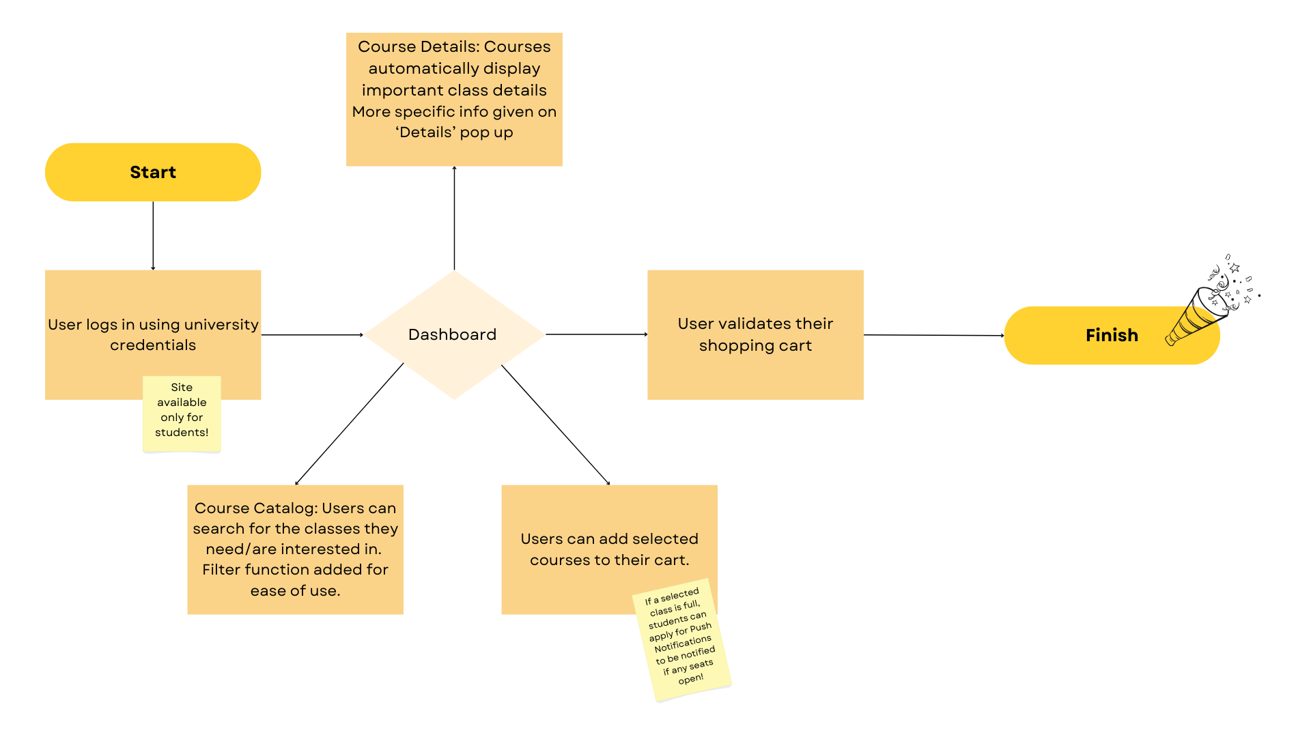
User Journey

Slide 4
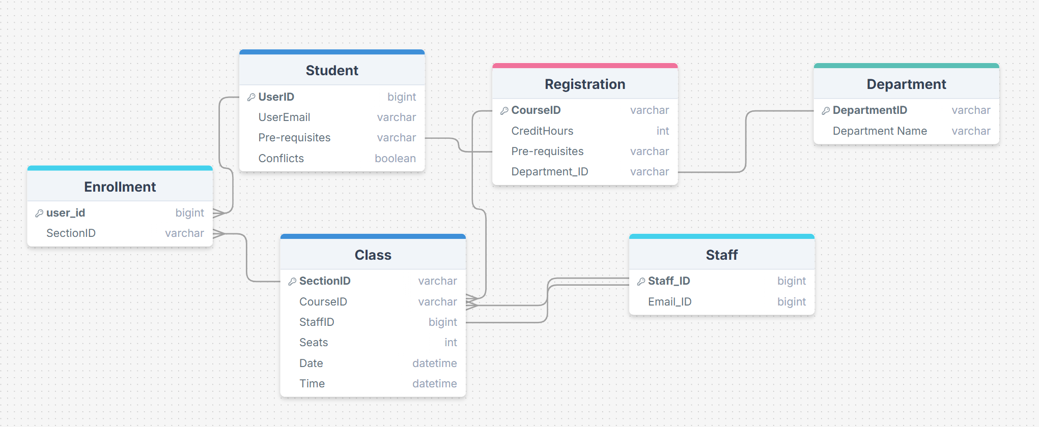
The Data
Data is segmented into a way that would make course lookup & enrollment convenient for the end-users

Slide 5






The Stack
Front End
Back End
Server
Database
Repository
Dashboard
Deployment

Slide 6
Front-end

Slide 7
User Interface
Dashboard Overview
Course Catalog Page:
Use a search bar and filters to browse courses
Each course has a course name, code, timing, instructor(s), location, etc
Course Details Pop-up:
Pop-up after users click on a course
Expands on class info. (i.e., prerequisites)
“Add to Cart”
Cart:
Courses put here for review. Shows total credits, final schedule, etc.
Users enroll here
Schedule View
How will users interact with the site?

Slide 8
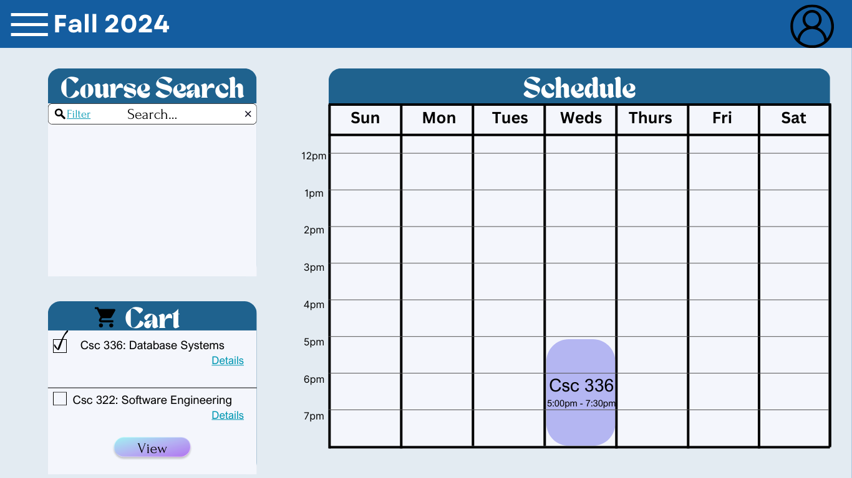
UI Sample

Slide 9
Back end

Slide 10
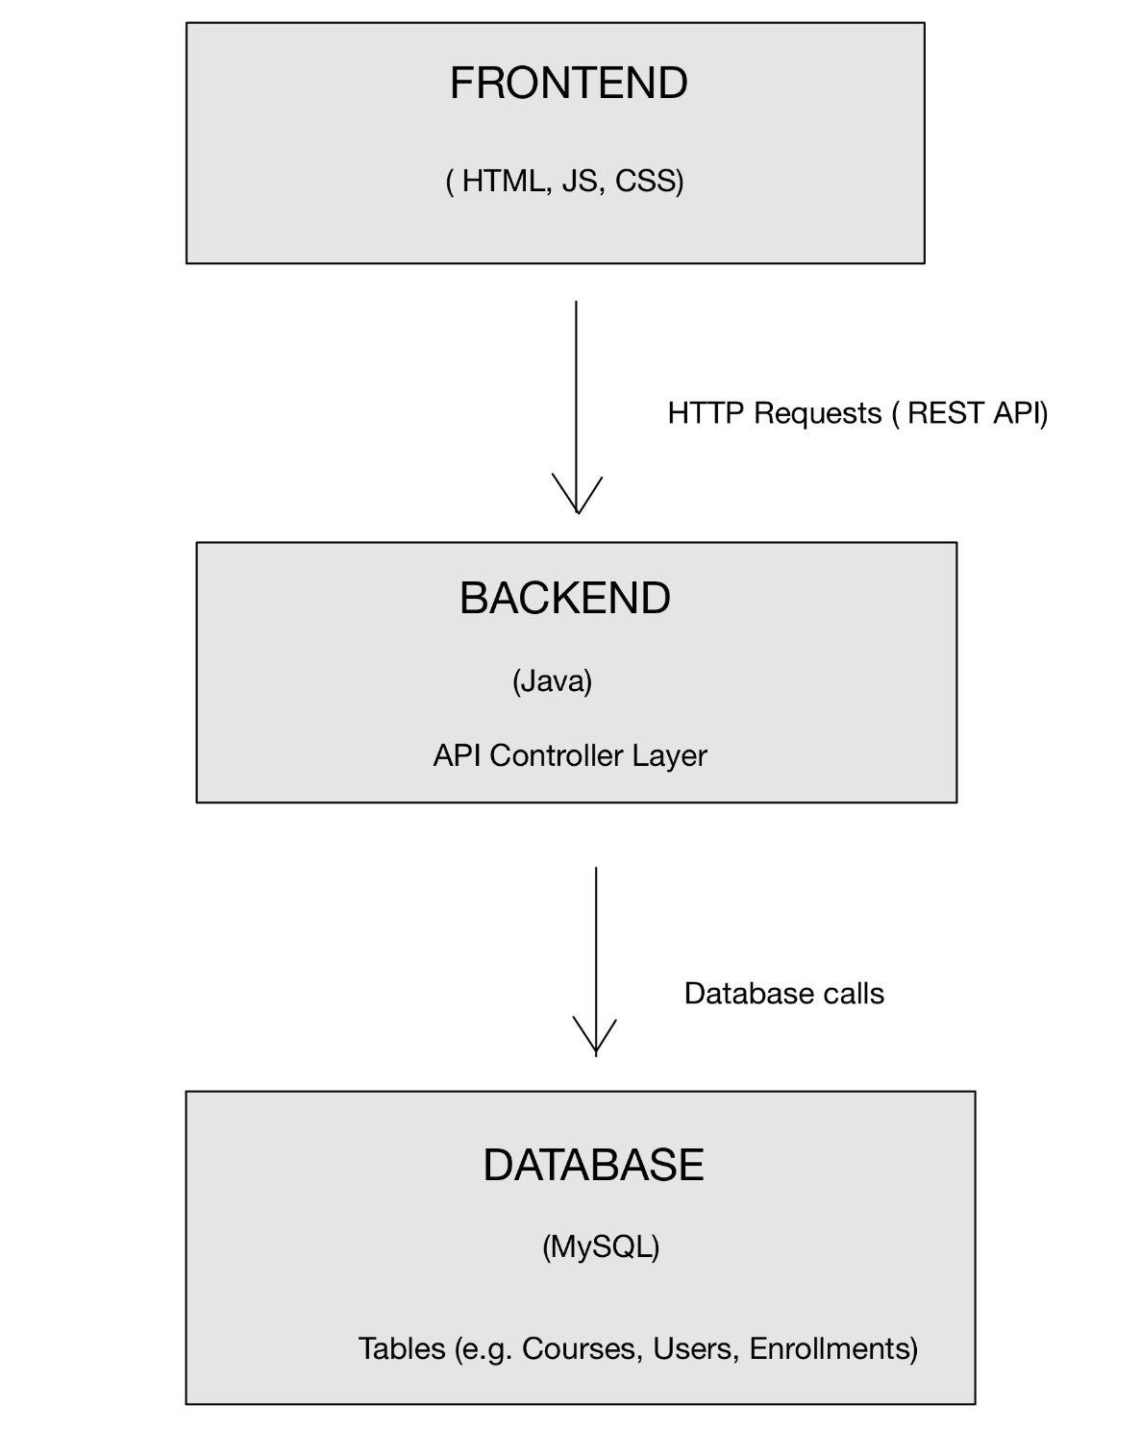
Backend Architecture Overview
Frontend Layer: Represents the user interface
Backend Layer: Manages API requests, processes logic, and handles data flow.
Database Layer: Stores and retrieves data, such as course and user information.

Slide 11
Security and Data Validation
User Authentication : Session-based authentication, where a user’s login credentials are verified, and a session is created to manage login status.
User Authorization : Restrict access based on roles, where only faculties can add or delete courses, while students can only view or enroll in courses.
Data validation : Check for required fields, such as course name and course ID, before storing in the database.

Slide 12
Member Roles
Member | Role
Amanda Farghli | Back End (Database)
Desiree Caceres | Front End
Jaime Perez | Front End
Suhana Lama | Back End (Server), Dashboard
Tak Kit Yeung | Back End (Server), Dashboard

Slide 13
Q&A

